Slide 1
Infrastructure as Code - Terraformujeme cloud
Viliam Púčik
DevOps Tech Lead
ZOOM International

Slide 2
On Premise vs Cloud

On Premise
Cloud

Slide 3



Major Cloud Providers

Slide 4
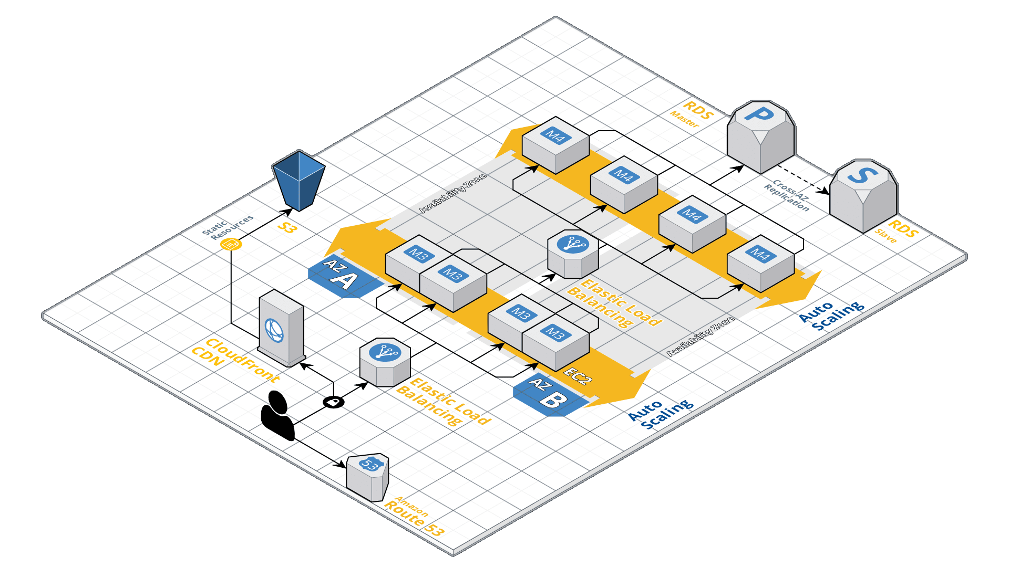
Complex
Infrastructure

Slide 5
Complex
Infrastructure
Development
Environment
Staging
Environment
Production
Environment

Slide 6
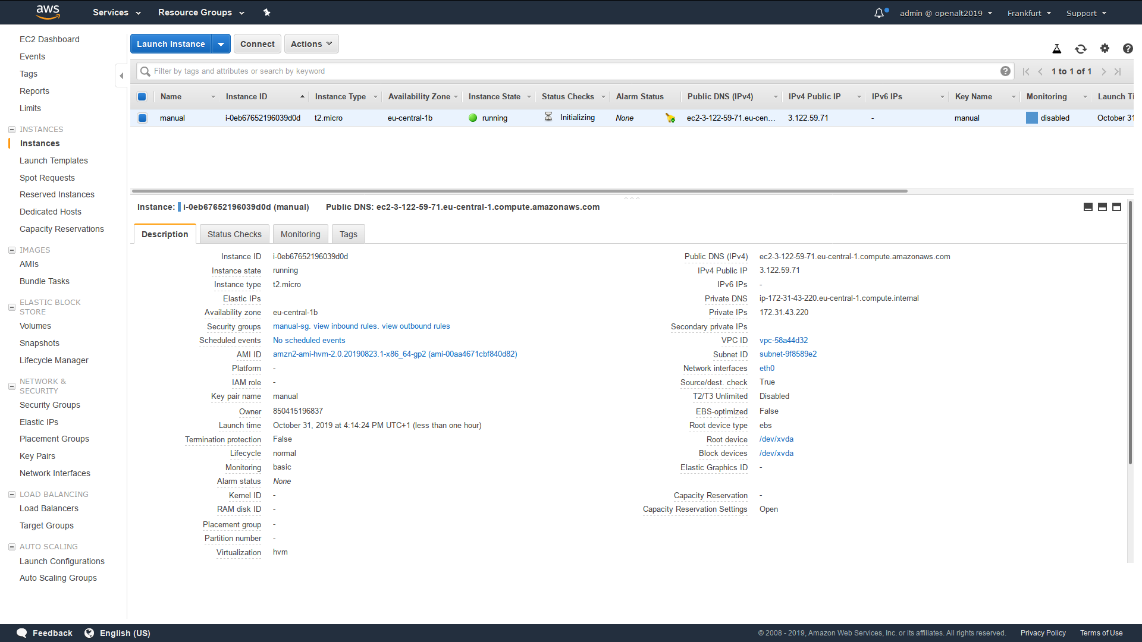
AWS Web Console

Slide 7
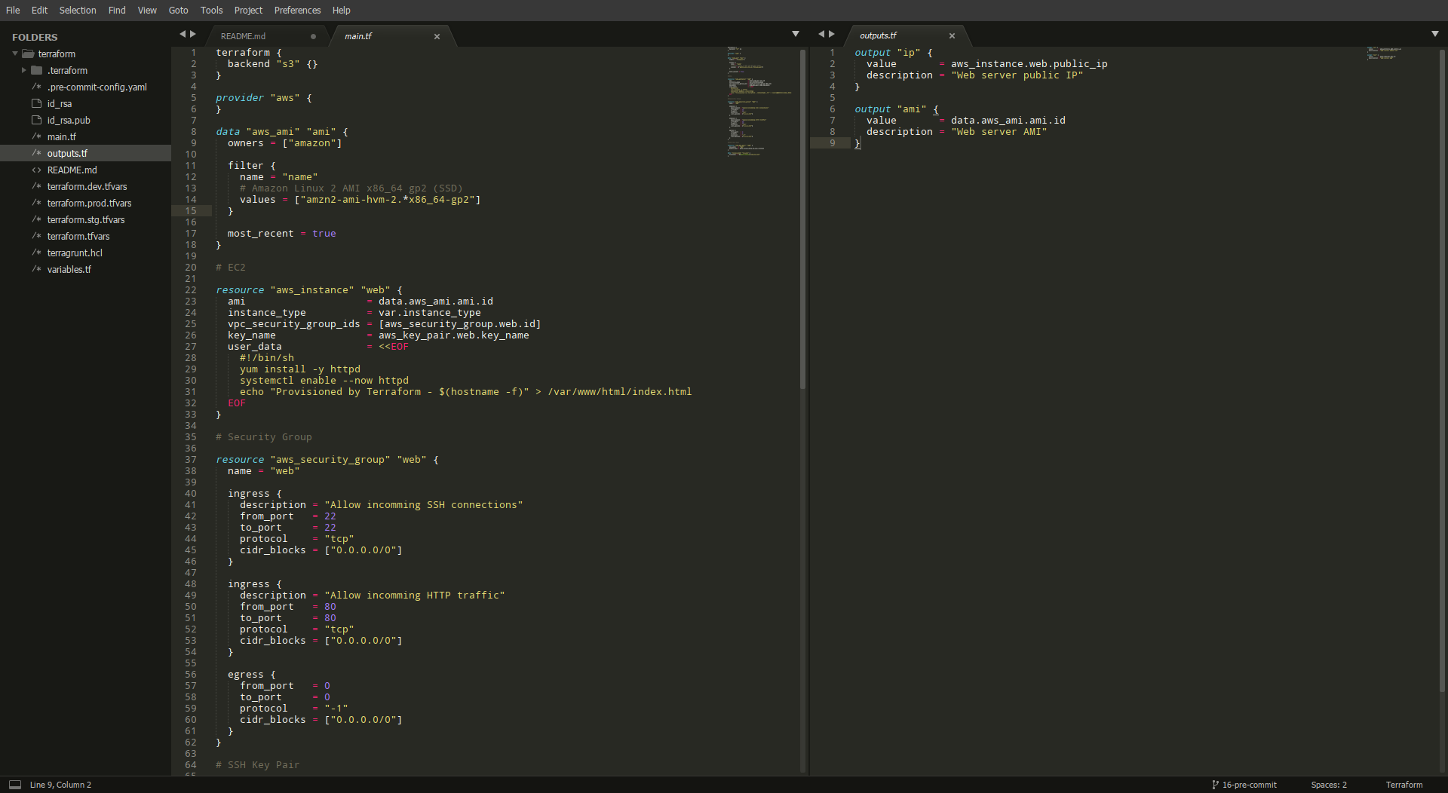

Infrastructure as Code

Slide 8

Infrastructure as Code
HashiCorp
Terraform
(Open Source)

Slide 9

Terraform
A tool for building, changing, and versioning infrastructure safely and efficiently. Building blocks:
Providers (AWS, GCP, Azure, MySQL, PostgreSQL, Kubernetes, Helm, GitHub and hundred of others)
Resources, Data Sources (read-only)
Input, Local and Output variables
Expressions and Functions
https://www.terraform.io/

Slide 10
Terraform State

Code

Cloud
Terraform

State

Slide 11
Let's
Demo

Slide 12
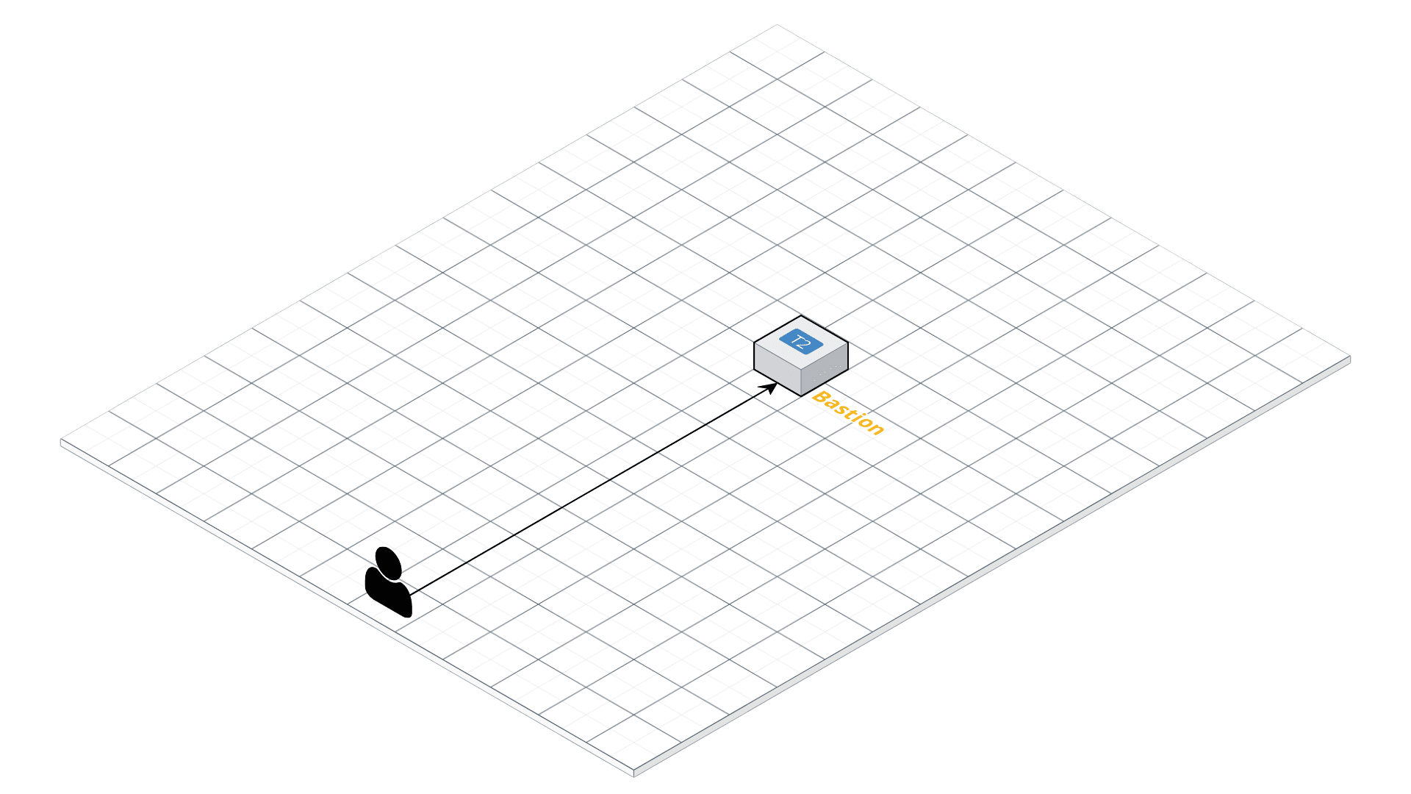
Actual
Demo :)

Slide 13
Terraform Meta Arguments
depends_on - for specifying hidden dependencies
count - for creating multiple resource instances according to a count
for_each - to create multiple instances according to a map - or set of strings
provider - for selecting a non-default provider configuration
lifecycle - for lifecycle customizations
provisioner and connection - for taking extra actions after resource creation

Slide 14
depends_on
resource "aws_instance" "bastion" {
vpc_security_group_ids = [
aws_security_group.bastion.id,
]
depends_on = [
aws_instance.web,
]
}

Slide 15
count
resource "aws_instance" "bastion" {
count = 10
}

Slide 16
count
variable "web_enabled" {
type = bool
default = false
}
resource "aws_instance" "web" {
count = var.web_enabled == true ? 1 : 0
}

Slide 17
for_each
variable "users" {
type = list(string)
default = ["admin", "developer", "manager"]
}
resource "aws_iam_user" "user" {
for_each = toset(var.users)
name = each.key
}

Slide 18
provider
provider "aws" {}
provider "aws" {
alias = "staging"
}
resource "aws_instance" "web" {
provider = aws.staging
}

Slide 19
lifecycle
resource "aws_instance" "web" {
lifecycle {
create_before_destroy = true
ignore_changes = [tags]
}
}

Slide 20
lifecycle
resource "aws_instance" "web" {
lifecycle {
prevent_destroy = true
}
}

Slide 21
provisioner
resource "null_resource" "id_rsa" {
provisioner "local-exec" {
working_dir = path.module
command = "ssh-keygen -N '' -f id_rsa"
}
}

Slide 22
provisioner
resource "aws_instance" "web" {
provisioner "remote-exec" {
inline = [
"sudo systemctl disable httpd",
]
}
}

Slide 23
provisioner
resource "aws_instance" "web" {
provisioner "file" {
source = "${path.module}conf/httpd.conf"
destination = "/etc/httpd/conf/httpd.conf"
}
}

Slide 24
provisioner
resource "aws_instance" "web" {
provisioner "file" {
...
connection {
type = "ssh"
user = "developer"
port = 2022
}
}
}

Slide 25

Terraform Modules
module "rds" {
source = "terraform-aws-modules/rds/aws"
version = "2.5.0"
# insert the 11 required variables here
}
https://registry.terraform.io/

Slide 26

Terragrunt
A thin wrapper for Terraform that provides extra tools for working with multiple Terraform modules. For example:
Creates remote state and locking resources automatically
Passes extra CLI arguments every time you run certain terraform commands
https://github.com/gruntwork-io/terragrunt

Slide 27
Questions?

Slide 28

Thank you!
https://a.openalt.cz/53

Slide 29

aws-vault
A tool to securely store and access AWS credentials in (development) environments.
Encrypts AWS keys
Provides temporary, one time credentials
https://github.com/99designs/aws-vault

Slide 30

Terraform Pre-Commit Framework
Automatically, before each commit:
Formats Terraform code
Updates README.md with the description of:
  terraform input variables
  terraform output variables
https://github.com/antonbabenko/pre-commit-terraform

